Slide 1
UNIT I: Introduction to Python

Slide 2
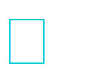
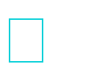
Differences between program and scripting language
Program
a program is executed (i.e. the source is first compiled, and the result of that compilation is expected)
A "program" in general, is a sequence of instructions written so that a computer can perform certain task. More syntax based
All lines are checked once and errors are throwned.
Scripting
a script is interpreted.
A "script" is code written in a scripting language. It mostly used to control other applications. Not more syntax based
Interpreter checks line by line errors.

Slide 3
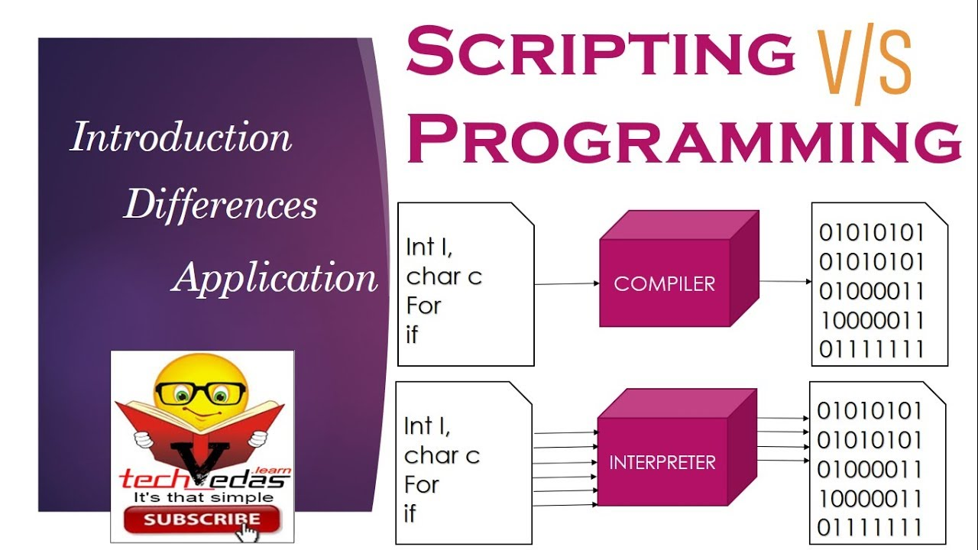

Slide 4

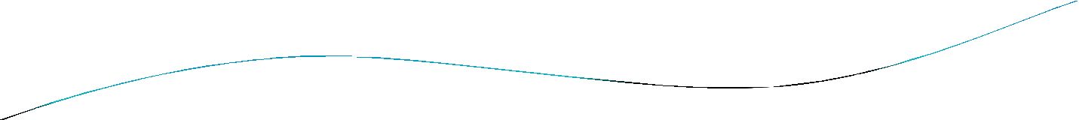


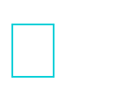
What is Python…?
Python is a general purpose programming language that supports both OOPs and procedural also.
So, Python is programming language as well as scripting language.
Python is also called as Interpreted language

Slide 5


History
Invented in the Netherlands, early 90s by Guido van Rossum
Python was conceived in the late 1980s and its implementation was started in December 1989
Guido Van Rossum is fan of ‘Monty Python’s Flying Circus’, this is a famous TV show in Netherlands

Slide 6
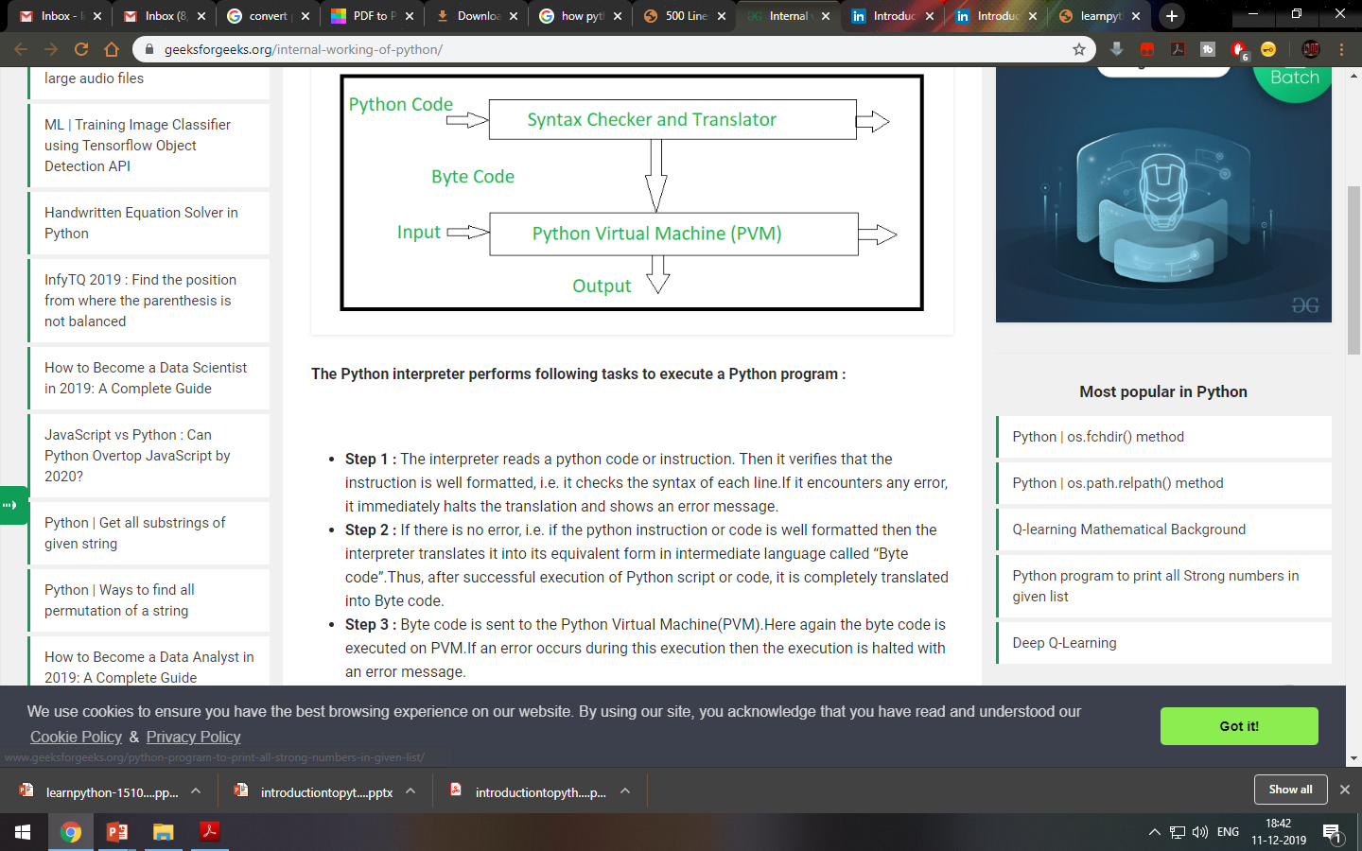

Slide 7
Advantages of Python
Most programs in Python require considerably less number of lines of code to perform the same task compared to other languages like C .
less programming errors and reduces the development time needed also.
Though Perl is a powerful language ,it is highly syntax oriented and many modules are not completed.

Slide 8

Scope of Python
Science
- Bioinformatics System Administration
Web Application Development
-CGI
Testing scripts

Slide 9

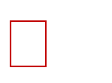
Why do people use Python…?
The following primary factors cited by Python users seem to be these:
Python is object-oriented
Structure supports such concepts as polymorphism, operation overloading, and multiple inheritance.
Indentation
Indentation is one of the greatest future in Python. It's free (open source)
Downloading and installing Python is free and easy Source code is easily accessible

Slide 10

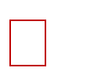
It's powerful
Dynamic typing
Built-in types and tools
Library utilities
Third party utilities (e.g. Numeric, NumPy, SciPy)
Automatic memory management It's portable
Python runs virtually every major platform used today
As long as you have a compatible Python interpreter installed, Python programs will run in exactly the same manner, irrespective of platform.

Slide 11

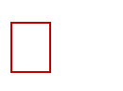
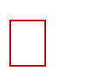
It's mixable
Python can be linked to components written in other languages easily
Linking to fast,compiled code is useful to computationally intensive problems
- Python/C integration is quite common
It's easy to use
No intermediate compile and link steps as in C/ C++
Python programs are compiled automatically to an intermediate form called bytecode, which the interpreter then reads
This gives Python the development speed of an interpreter without
the performance loss inherent in purely interpreted languages
It's easy to learn
Structure and syntax are pretty intuitive and easy to grasp

Slide 12

Who uses python today…
Python is being applied in real revenue-generating products by real companies. For instance:
Google makes extensive use of Python in its web search system, and employs Python’s creator.
Intel, Cisco, Hewlett-Packard, Seagate, Qualcomm, and IBM use Python for hardware testing.
ESRI(Environmental Systems Research Institute) uses Python as an end-user customization tool for its popular GIS mapping products.
The YouTube video sharing service is largely written in Python

Slide 13

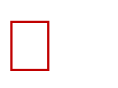
Installing Python
Python is pre-installed on most Unix systems, including Linux and MAC OS
But for in Windows Operating Systems , user can download from the https://www.python.org/downloads/
- from the above link download latest version of python IDE and install, recent version is 3.4.1 but most of them uses version 2.7.7 only

Slide 14
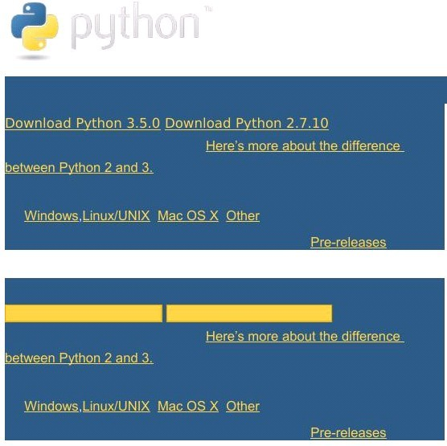
..
The website appears as shown below.
https://www.python.org/downloads/

Slide 15
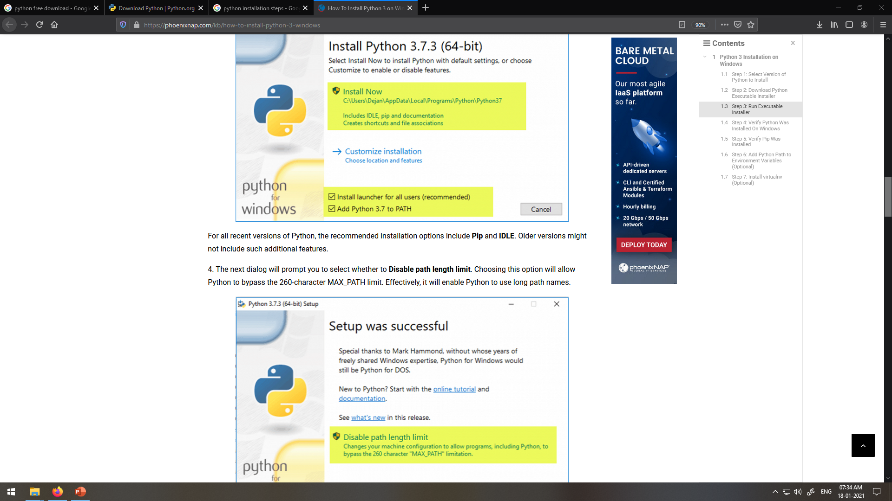
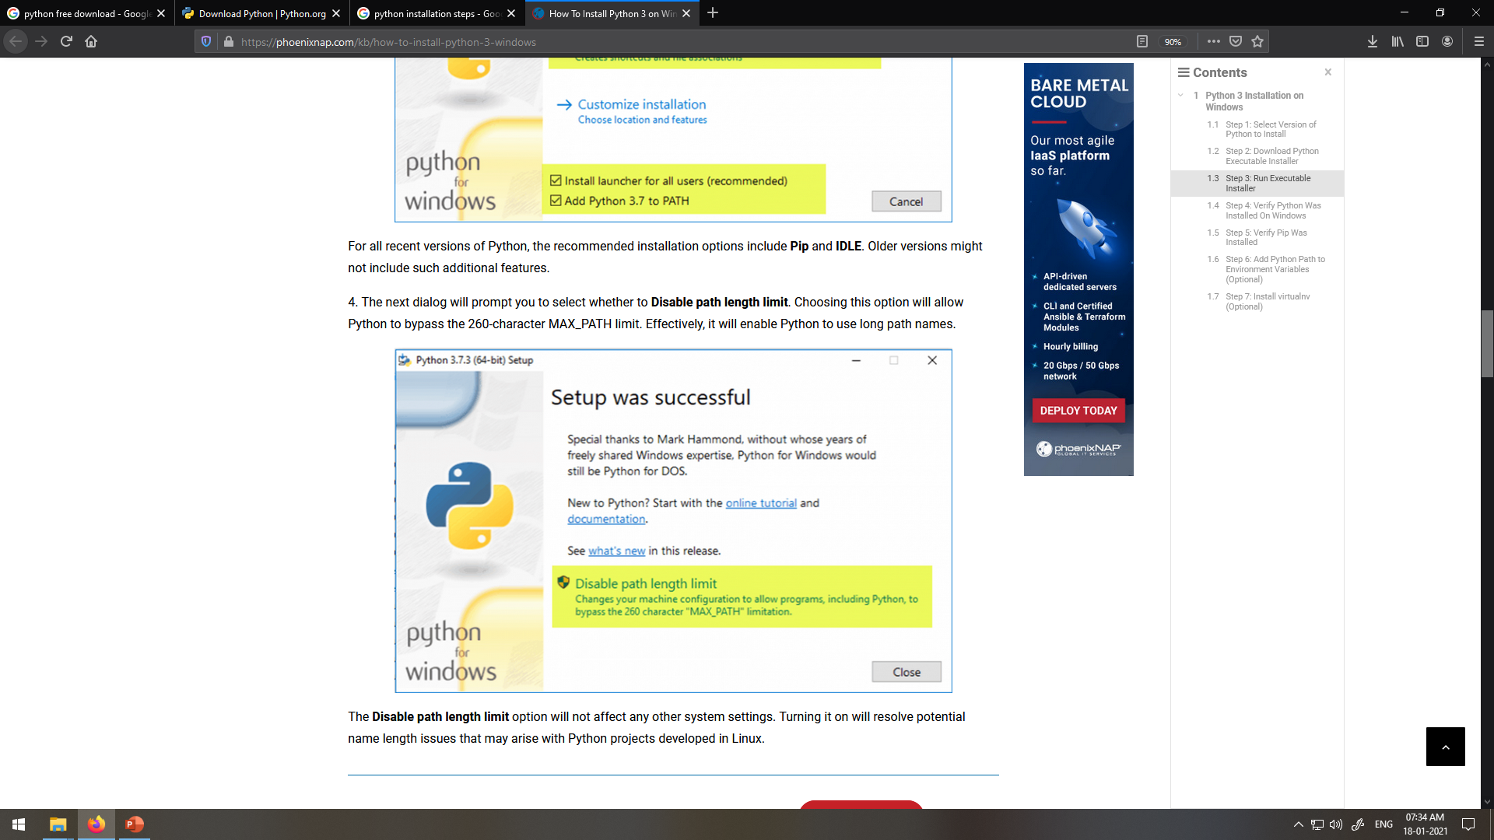

Slide 16
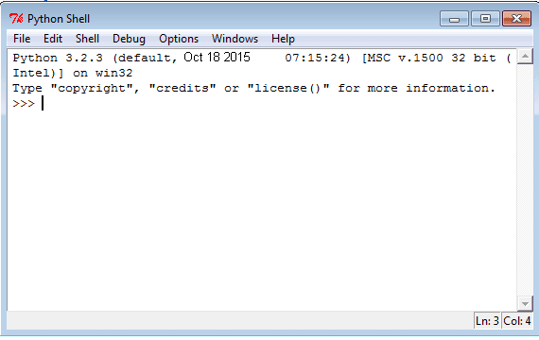
IDLE
IDLE is a graphical user interface for doing Python development, and is a standard and free part of the Python system.
It is usually referred to as an Integrated Development Environment (IDLE).
One can write the Python code or script using the IDLE which is like an editor.This comes along with Python bundle.

Slide 17
Python Basics:
Comment lines begin with: #
File Naming Scheme
filename.py (programs)
Example program:
>> print(“Hello, World!\n”)

Slide 18
Python Data Types
Python Data Type – Numeric
Python Data Type – String
Python Data Type – List
Python Data Type – Tuple
Dictionary

Slide 19
Python Data Type – Numeric
Python numeric data type is used to hold numeric values like;
int – holds signed integers of non-limited length.
long- holds long integers(exists in Python 2.x, deprecated in Python 3.x).
float- holds floating precision numbers and it’s accurate upto 15 decimal places.
complex- holds complex numbers.

Slide 20
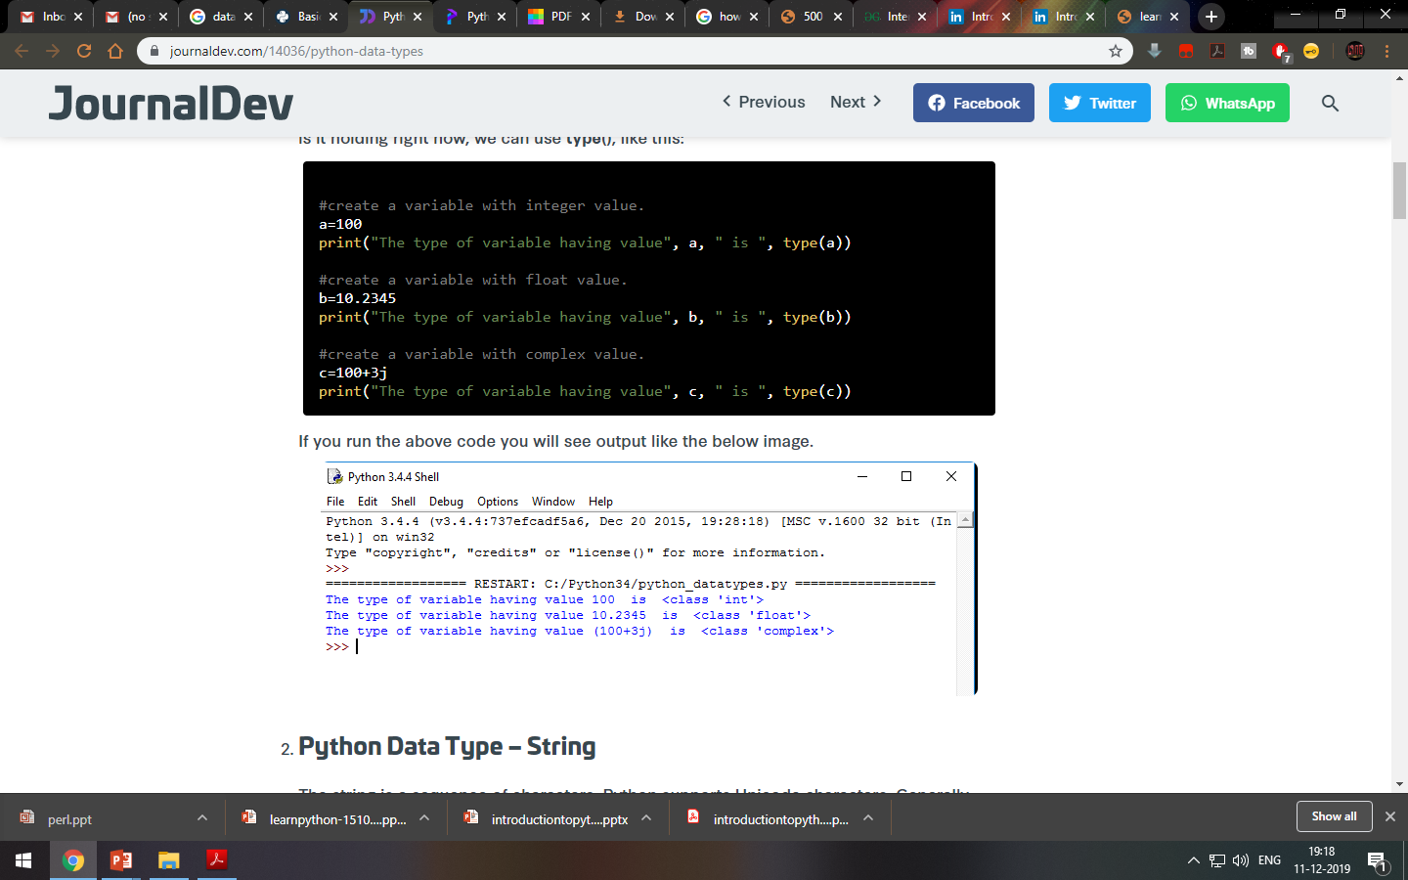

Slide 21
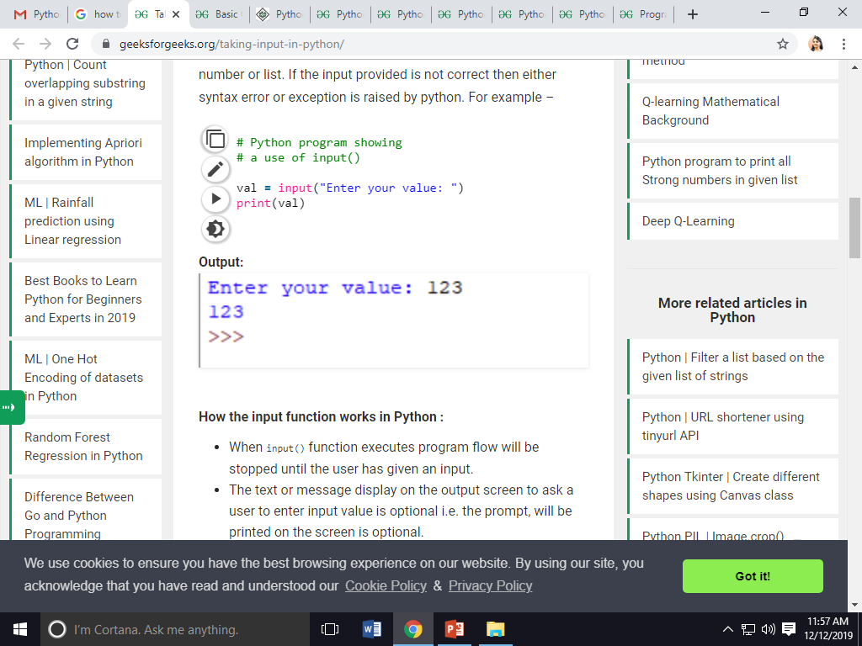
Taking input in Python
input ( prompt ):
This function first takes the input from the user and then evaluates the expression, which means Python automatically identifies whether user entered a string or a number or list.
# Python program showing
val = input("Enter your value: ")
print(val)

Slide 22
Basic Operators
1. Athematic Operators:
For example ,if x= 7,y=2
addition: x+y=9
subtraction:x-y=5
Multiplication:x*y=14
Division: x/y=3.5
Floor division: x // y=3(rounds off the answer to the nearest whole number)
Modulus: x%y= 1(Gives the remainder when 7 is divided by 2
Exponent : x**y=49(7 to the power of 2)

Slide 23
2. Relational Operators:
Relational operators compares the values. It either returns True or False according to the condition.

Slide 24
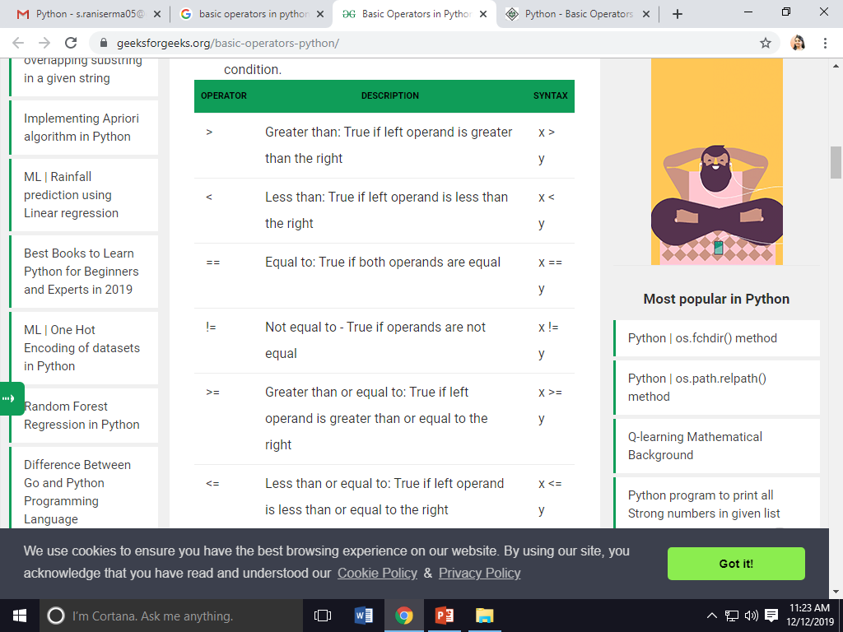

Slide 25
# Examples of Relational Operators
a = 13
b = 33
print(a > b)
print(a < b)
print(a == b)
print(a != b)
print(a >= b)
print(a <= b)
Output:
False
True
False
True
False
True

Slide 26
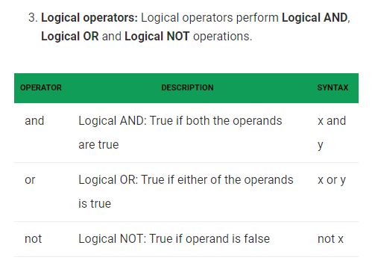

Slide 27
# Examples of Logical Operator
a = True
b = False
# Print a and b is False
print(a and b)
# Print a or b is True
print(a or b)
# Print not a is False
print(not a)
Output:
False
True
False

Slide 28
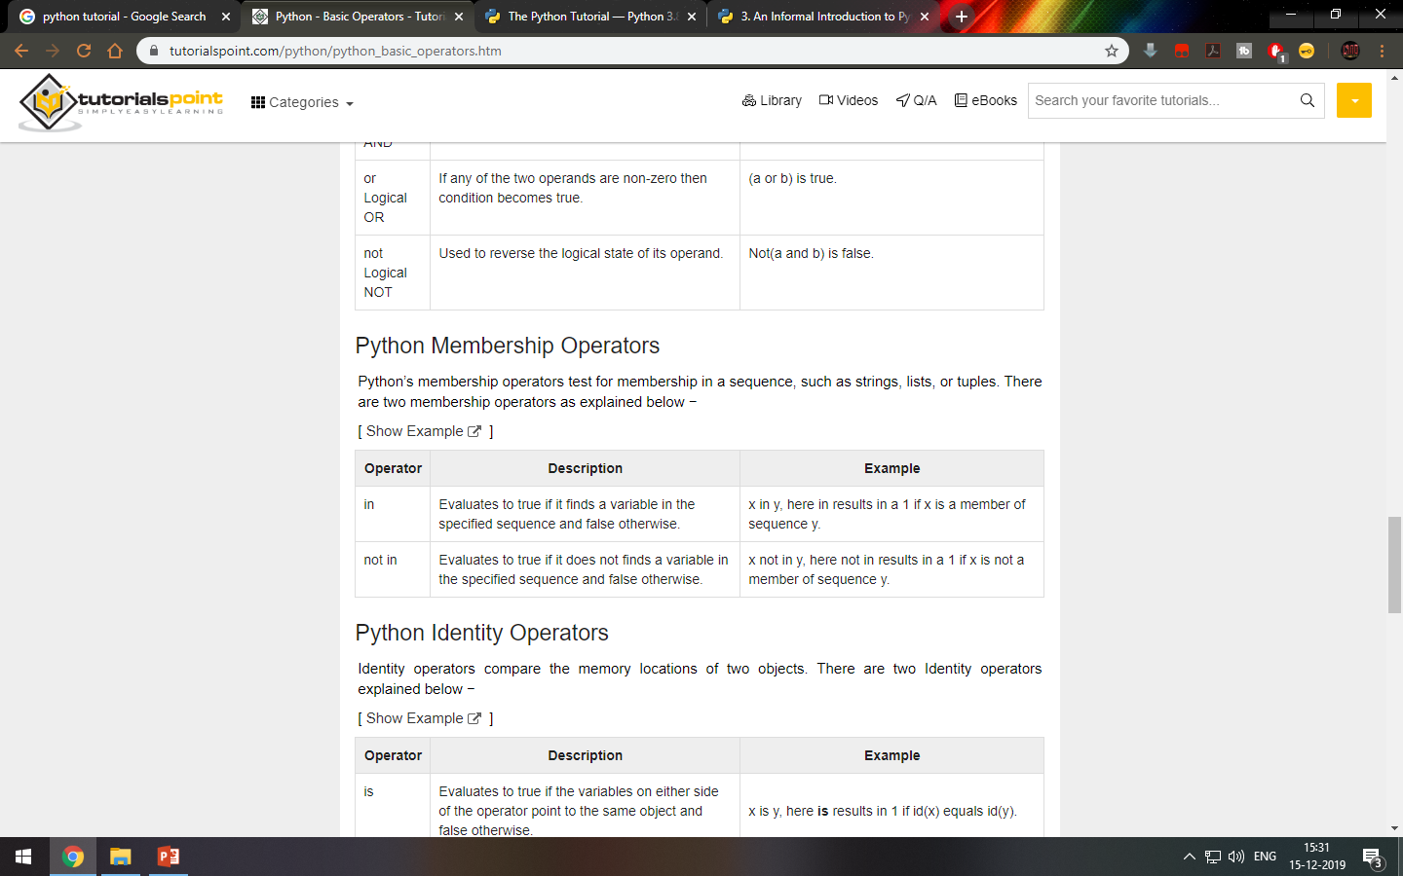

Slide 29
Example:
a = 10
b = 20
list = [1, 2, 3, 4, 5 ];
if ( a in list ):
print "Line 1 - a is available in the given list"
else:
print "Line 1 - a is not available in the given list"
if ( b not in list ):
print "Line 2 - b is not available in the given list"
else:
print "Line 2 - b is available in the given list"
a = 2
if ( a in list ):
print "Line 3 - a is available in the given list"
else:
print "Line 3 - a is not available in the given list“
When you execute the above program it produces the following result −
Line 1 - a is not available in the given list
Line 2 - b is not available in the given list
Line 3 - a is available in the given list

Slide 30
4. Assignment operators:
Assignment operators are used to assign values to the variables.
Syntax:
=
Example:
X=10
Print(x)

Slide 31
2. Python Data Type – String
The string is a sequence of characters.
Python supports Unicode characters.
Generally, strings are represented by either single or double quotes.

Slide 32
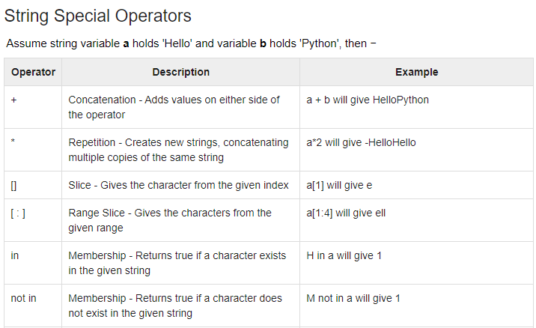

Slide 33
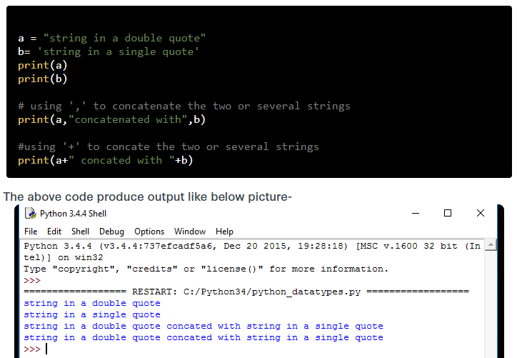

Slide 34
Example 2:
str = 'Hello World!'
print str # Prints complete string
print str[0] # Prints first character of the string
print str[2:5] # Prints characters starting from 3rd to 5th
print str[2:] # Prints string starting from 3rd character
print str * 2 # Prints string two times
print str + "TEST" # Prints concatenated string
This will produce the following result −
Hello World!
H
llo
llo World!
Hello World!Hello World!
Hello World!TEST

Slide 35
Python Data Type – List
The list is a versatile data type exclusive in Python.
In a sense, it is the same as the array in C/C++.
But the interesting thing about the list in Python is it can simultaneously hold different types of data.
Formally list is an ordered sequence of some data written using square brackets([]) and commas(,).

Slide 36
Add and Remove items
To add items the append() function is useful.
For ex : userAge.append(100) will add the value 100 to the List at the end. Now the new List is userAge=[15,25,30,45,50.65.55,100]
To remove any value from the List we write del listName[index of item to be deleted]
For ex: del userAge[2] will give a new List userAge=[15,25,45,50,65,55,100]

Slide 37
Example 1:
list = [ 'abcd', 786 , 2.23, 'john', 70.2 ]
tinylist = [123, 'john']
print list # Prints complete list
print list[0] # Prints first element of the list
print list[1:3] # Prints elements starting from 2nd till 3rd
print list[2:] # Prints elements starting from 3rd element
print tinylist * 2 # Prints list two times
print list + tinylist # Prints concatenated lists
This produce the following result −
['abcd', 786, 2.23, 'john', 70.2]
abcd
[786, 2.23]
[2.23, 'john', 70.2]
[123, 'john', 123, 'john']
['abcd', 786, 2.23, 'john', 70.2, 123, 'john']

Slide 38
Updating Lists and Adding new elements:
You can update single or multiple elements of lists by giving the slice on the left-hand side of the assignment operator, and you can add to elements in a list with the append() method. For example −
Example:
list = ['physics', 'chemistry', 1997, 2000];
print "Value available at index 2 : “+list[2]
list[2] = 2001;
print "New value available at index 2 : “+list[2]
list.append(1998)
print list
OUTPUT−
Value available at index 2 :1997
New value available at index 2 :
2001
'physics', 'chemistry’, 2001, 2000,1998

Slide 39
Delete List Elements
To remove a list element, you can use either the del statement if you know exactly which element(s) you are deleting or the remove() method if you do not know. For example −
Example:
list1 = ['physics', 'chemistry', 1997, 2000];
print list1
del list1[2];
print "After deleting value at index 2 : "
print list1
OUTPUT−
['physics', 'chemistry', 1997, 2000]
After deleting value at index 2 :
['physics', 'chemistry', 2000]

Slide 40
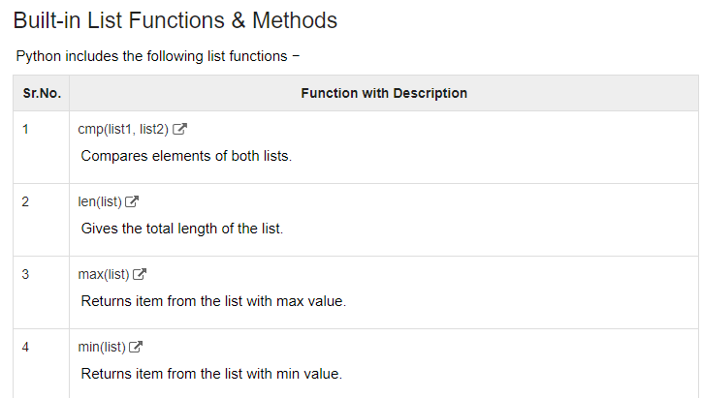

Slide 41
Write a Python script to store roll number of 5 students in list and perform the following:
Find length of a list
Display the smallest element from a list
Display largest element from a list.

Slide 42
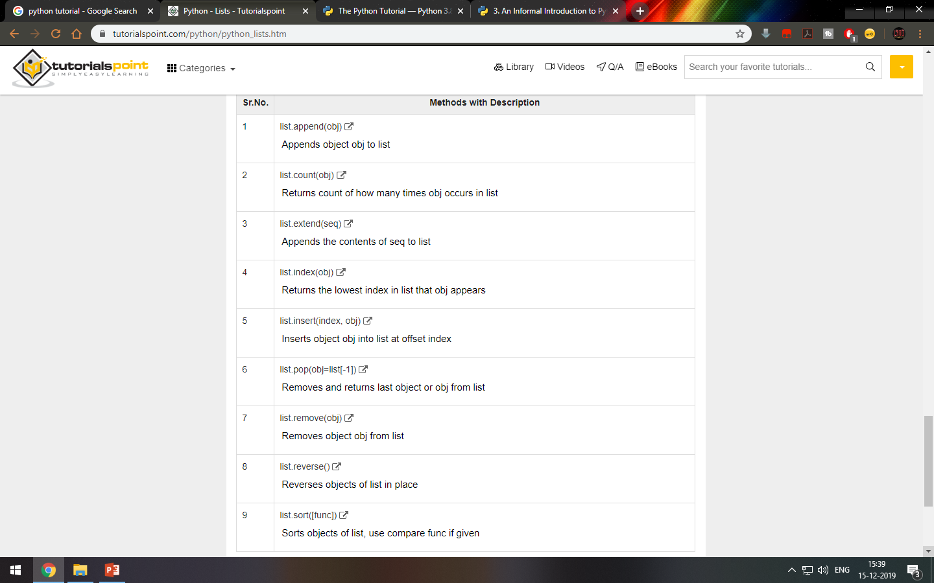

Slide 43
Q.1) Write a Python script to store dna sequence a in list and perform the following:
Find count of occurrences of alphabet ‘atgc’ in a list
Display the first element from a list
Display last element from a list.
Q.2) Write a Python to store 5 number using list and display reverse of a list and sorting of a list

Slide 44
Python Data Type – Tuple
Tuple is another data type which is a sequence of data similar to list.
But it is immutable. That means data in a tuple is write protected.
Data in a tuple is written using parenthesis and commas.

Slide 45
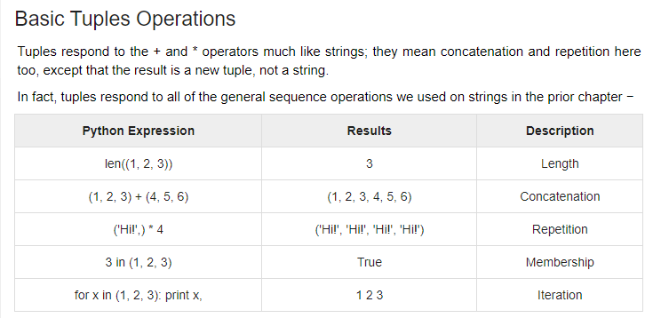

Slide 46
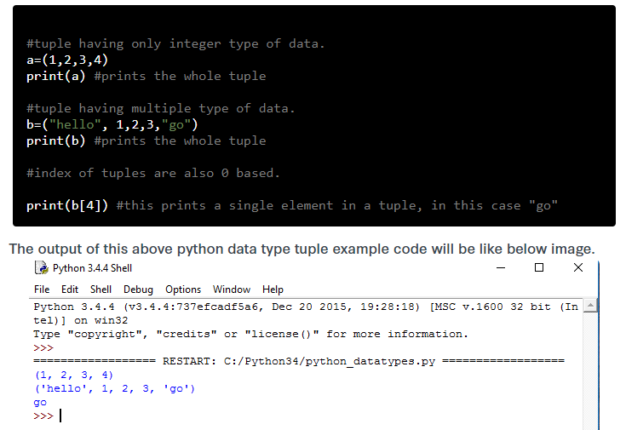

Slide 47
Example 2:
tuple = ( 'abcd', 786 , 2.23, 'john', 70.2 )
tinytuple = (123, 'john')
print tuple # Prints complete list
print tuple[0] # Prints first element of the list
print tuple[1:3] # Prints elements starting from 2nd till 3rd
print tuple[2:] # Prints elements starting from 3rd element
print tinytuple * 2 # Prints list two times
print tuple + tinytuple # Prints concatenated lists
This produce the following result −
('abcd', 786, 2.23, 'john', 70.2)
abcd
(786, 2.23)
(2.23, 'john', 70.2)
(123, 'john', 123, 'john')
('abcd', 786, 2.23, 'john', 70.2, 123, 'john')

Slide 48
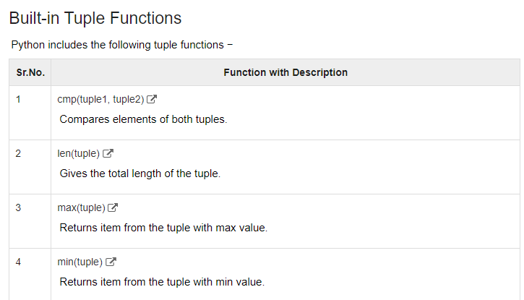

Slide 49
Dictionary
Python Dictionary is an unordered sequence of data of key-value pair form.
It is similar to the hash table type.
Dictionaries are written within curly braces in the form key:value.
It is very useful to retrieve data in an optimized way among a large amount of data.

Slide 50
Accessing Values in Dictionary
To access dictionary elements, you can use the familiar square brackets along with the key to obtain its value. Following is a simple example −
Example :
dict = {'Name': 'Zara', 'Age': 7, 'Class': 'First'}
print "dict['Name']: ", dict['Name']
print "dict['Age']: ", dict['Age']
When the above code is executed, it produces the following
Result −
dict['Name']: Zara
dict['Age']: 7

Slide 51
Updating or Adding new element to a Dictionary
You can update a dictionary by adding a new entry or a key-value pair, modifying an existing entry, or deleting an existing entry as shown below in the simple example −
Example:
dict = {'Name': 'Zara', 'Age': 7, 'Class': 'First'}
dict['Age'] = 8; # update existing entry
dict['School'] = "DPS School"; # Add new entry
print "dict['Age']: ", dict['Age']
print "dict['School']: ", dict['School']
When the above code is executed, it produces the following
Result −
dict['Age']: 8
dict['School']: DPS School

Slide 52
Delete Dictionary Elements
You can either remove individual dictionary elements or clear the entire contents of a dictionary. You can also delete entire dictionary in a single operation.
To explicitly remove an entire dictionary, just use the del statement. Following is a simple example −
Example:
dict = {'Name': 'Zara', 'Age': 7, 'Class': 'First'}
del dict['Name']; # remove entry with key 'Name'
dict.clear(); # remove all entries in dict
print "dict['Age']: ", dict['Age']
print "dict['School']: ", dict['School']
Result:
dict['Age']:
Traceback (most recent call last):
File "test.py", line 4, in <module>
print "dict['Age']: ", dict['Age'];
TypeError: 'type' object is unsubscriptable

Slide 53
Example :
dict = {}
dict['one'] = "This is one"
dict[2] = "This is two"
tinydict = {'name': 'john','code':6734, 'dept': 'sales'}
print dict['one'] # Prints value for 'one' key
print dict[2] # Prints value for 2 key
print tinydict # Prints complete dictionary
print tinydict.keys() # Prints all the keys
print tinydict.values() # Prints all the values
This produce the following result −
This is one
This is two
{'dept': 'sales', 'code': 6734, 'name': 'john'}
['dept', 'code', 'name']
['sales', 6734, 'john']

Slide 54
CONDITIONAL STATEMENTS

Slide 55
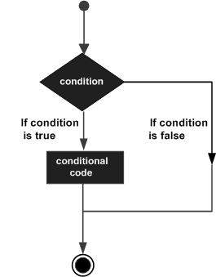
Python - Decision Making
Decision structures evaluate multiple expressions which produce TRUE or FALSE as outcome.
You need to determine which action to take and which statements to execute if outcome is TRUE or FALSE otherwise.
Following is the general form of a typical decision making structure found in most of the programming languages −

Slide 56
1. Python IF Statement
It is similar to that of other languages.
The if statement contains a logical expression using which data is compared and a decision is made based on the result of the comparison.
Syntax
if expression:
statement(s)
If the boolean expression evaluates to TRUE, then the block of statement(s) inside the if statement is executed. If boolean expression evaluates to FALSE, then the first set of code after the end of the if statement(s) is executed.

Slide 57
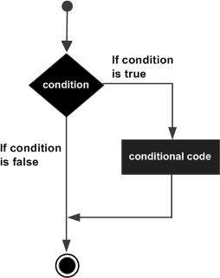

Slide 58
Example:
var1 = 100
if var1==100:
print "Got a true expression value"
print var1
OUTPUT:
Got a true expression value
100

Slide 59
2. Python IF…ELSE Statements
An else statement can be combined with an if statement.
An else statement contains the block of code that executes if the conditional expression in the if statement resolves to 0 or a FALSE value.
The else statement is an optional statement and there could be at most only one else statement following if.
Syntax
The syntax of the if...else statement is −
if expression:
statement(s)
else:
statement(s)

Slide 60
Example:
var1 = 100
if var1==10:
print("Got a true expression value“)
print(var1)
else:
print("Got a false expression value“)
print(var1)
OUTPUT:
Got a FALSE expression value
100

Slide 61
3. Python nested IF statements
There may be a situation when you want to check for another condition after a condition resolves to true. In such a situation,
you can use the nested if construct.
In a nested if construct, you can have an if...elif...else construct inside another if...elif...else construct.
Syntax
The syntax of the nested if...elif...else construct may be −
if expression2:
statement(s)
elif expression3:
statement(s)
elif expression4:
statement(s)
else:
statement(s)

Slide 62
Example
var = 100
if var < 200:
print "Expression value is less than 200"
if var == 150:
print "Which is 150"
elif var == 100:
print "Which is 100"
elif var == 50:
print "Which is 50"
elif var < 50:
print "Expression value is less than 50"
else:
print "Could not find true expression"
Output−
Expression value is less than 200
Which is 100

Slide 63
FUNCTIONS

Slide 64
Python - Functions
A function is a block of organized, reusable code that is used to perform a single, related action. ‘
Functions provide better modularity for your application and a high degree of code reusing.
As you already know, Python gives you many built-in functions like print(), etc. but you can also create your own functions. These functions are called user-defined functions.

Slide 65
Defining a Function
You can define functions to provide the required functionality. Here are simple rules to define a function in Python.
Function blocks begin with the keyword def followed by the function name and parentheses ( ) .
Any input parameters or arguments should be placed within these parentheses.
The code block within every function starts with a colon (:).
The statement return [expression] exits a function
Syntax
def functionname( parameters ):
function_suite
return [expression]

Slide 66
Example 1:
# Function definition is here
def printme( str ):
print str
return;
# Now you can call printme function
printme("I'm first call to user defined function!")
printme("Again second call to the same function")
Output:
I'm first call to user defined function!
Again second call to the same function

Slide 67
Example 2:
# Function definition is here
def sum( arg1, arg2 ):
total = arg1 + arg2
print "Inside the function : ", total
return;
# Now you can call sum function
total = sum( 10, 20 );

Slide 68
Python Loops
Python has two primitive loop commands:
1. for loops
2. while loops

Slide 69
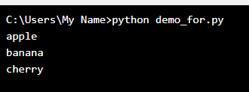
Python For Loops
A for loop is used for iterating over a sequence (that is either a list, a tuple, a dictionary, a set, or a string).
Example
Print each fruit in a fruit list:
fruits = ["apple", "banana", "cherry"]
for x in fruits:
print(x)

Slide 70
The while Loop
With the while loop we can execute a set of statements as long as a condition is true.
Example
//Print i as long as i is less than 6:
i = 1
while i < 6:
print(i)
i += 1
output:
12345

Slide 71
Python break statement
The break statement terminates the loop containing it.
Control of the program flows to the statement immediately after the body of the loop.
If break statement is inside a nested loop (loop inside another loop), break will terminate the innermost loop and comes to outerloop.
Syntax of break
break

Slide 72
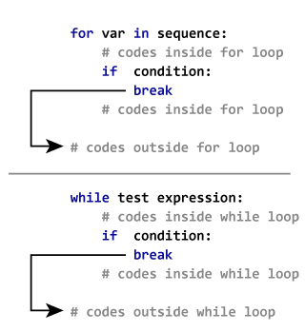
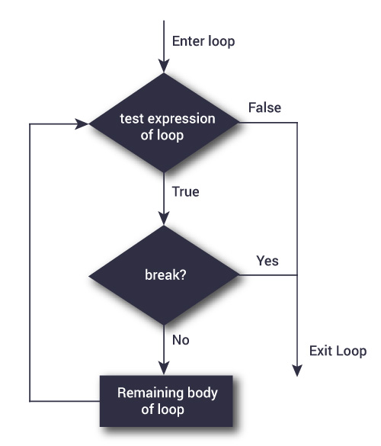
Python break statement
Example: Python break

Slide 73
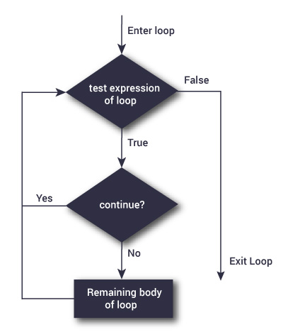
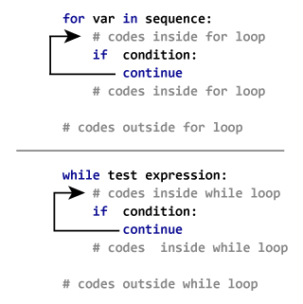
Continue:

Slide 74
File Handling

Slide 75
File handling
File handling is an important part of any web application or biological sequence.
Python has several functions for creating, reading, updating, and deleting files.
The key function for working with files in Python is the open() function.
The open() function takes two parameters; filename, and mode.
There are four different methods (modes) for opening a file:
"r" - Read - Default value. Opens a file for reading, error if the file does not exist
"a" - Append - Opens a file for appending, creates the file if it does not exist
"w" - Write - Opens a file for writing, creates the file if it does not exist
"x" - Create - Creates the specified file, returns an error if the file exists

Slide 76
In addition you can specify if the file should be handled as binary or text mode
"t" - Text - Default value. Text mode
"b" - Binary - Binary mode
Syntax
f = open("demofile.txt")
The code above is the same as:
f = open("demofile.txt", "r")
Note: Make sure the file exists, or else you will get an error.

Slide 77
read():
dnafile.txt
atgcaaatgcc
attgc
aattttgggccc
To open the file, use the built-in open() function.
Example: Read dna sequence and display
f = open("dnafile.txt", "r")
print(f.read())
f.close()
Output:
atgcaaatgcc
attgc
aattttgggccc
Note :
f.read(5): reads only 5 characters from start

Slide 78
readLine():
dnafile.txt
atgcaaatgcc
attgc
aattttgggccc
Example: Read first dna sequence and display
f = open("dnafile.txt", "r")
print(f.readLine())
f.close()
Output:
atgcaaatgcc

Slide 79
Example
Loop through the file line by line:
f = open("demofile.txt", "r")
for x in f:
print(x)
f.close()

Slide 80
Write :
Write to an Existing File
To write to an existing file, you must add a parameter to the open() function:
"a" - Append - will append to the end of the file
"w" - Write - will overwrite any existing content
Example:
f = open("demofile2.txt", "a")
f.write(“atttgggatc")
f.close()
#open and read the file after the appending:
f = open("dnafile.txt", "r")
print(f.read())
f.close()
Output:
atgcaaatgcc
attgc
aattttgggccc
atttgggatc

Slide 81
Python Delete File
Delete a File
To delete a file, you must import the OS module, and run its os.remove() function:
Example
Remove the file "demofile.txt":
import os
os.remove("dnafile.txt")

Slide 82
Classwork 1. Python Program to Calculate the Area of a Triangle 2. Python Program to Find the Largest Among Three Numbers 3. Python Program to Remove Punctuations From a String 4. Write a Python program to get the 4th element and 4th element from last of a tuple.

